Slide 1

CITRPG
Laci Parker & Hamid Sutton

Slide 2

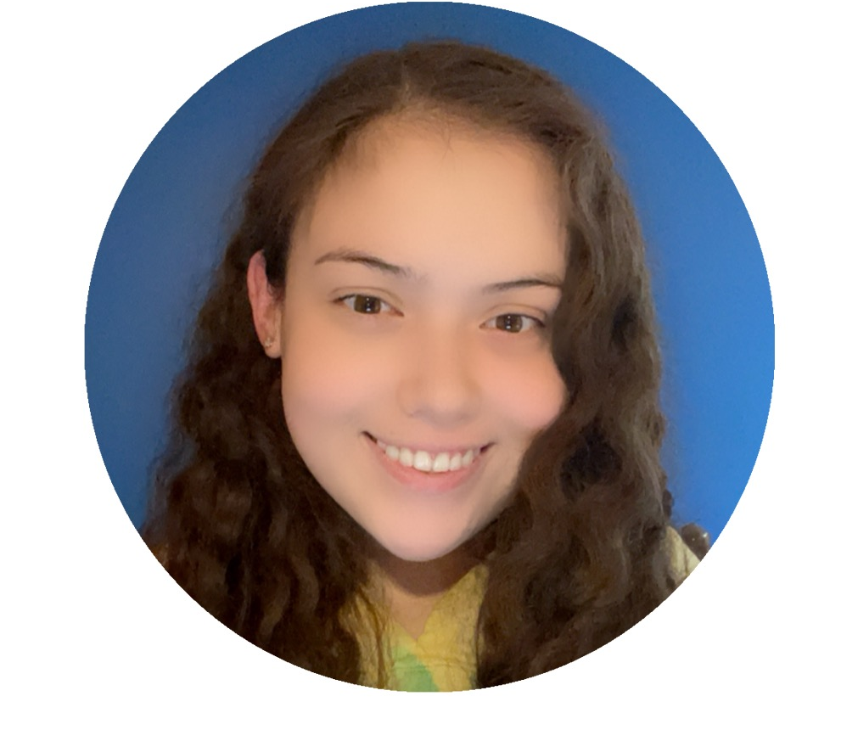
Team
Laci Parker
Cybersecurity Major
Hamid Sutton
CIS Major

Slide 3
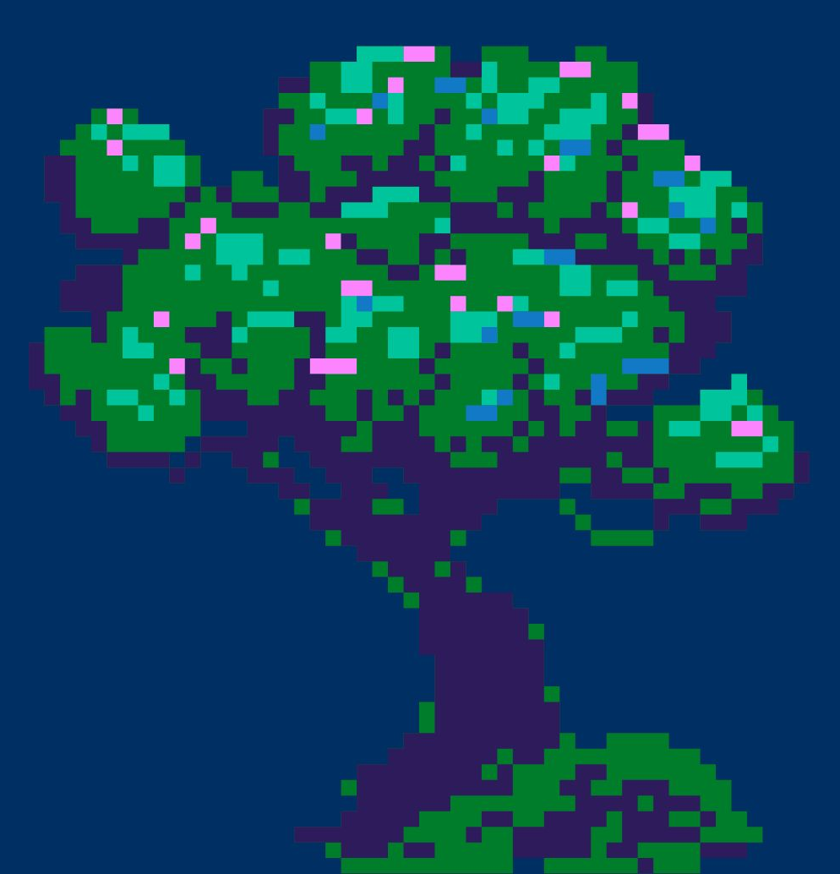
Problem
The problem we want to solve in making a computer trivia game is to make it enjoyable for everyone.
We want to have questions that are not too easy or too hard so beginners and experienced players can have fun playing and learn something new.
We want to make the game interesting and inclusive for everyone.

Slide 4
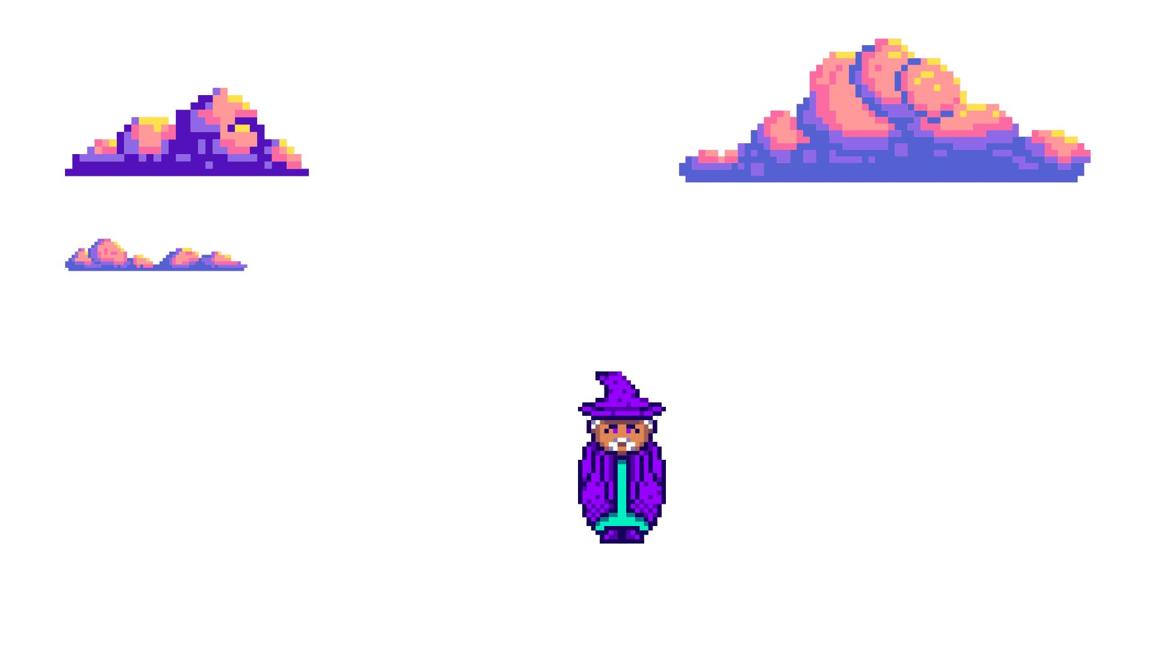
Solution
To build a trivia game is like putting a puzzle together. You have the following tools.
Javascript holds the game together to make everything functional.
Html provides structure to the game's content.
CSS is about coloring and styling. It makes it more appealing.
Bootstrap handles the ultimate set of tools you need to make sure everything works.

Slide 5
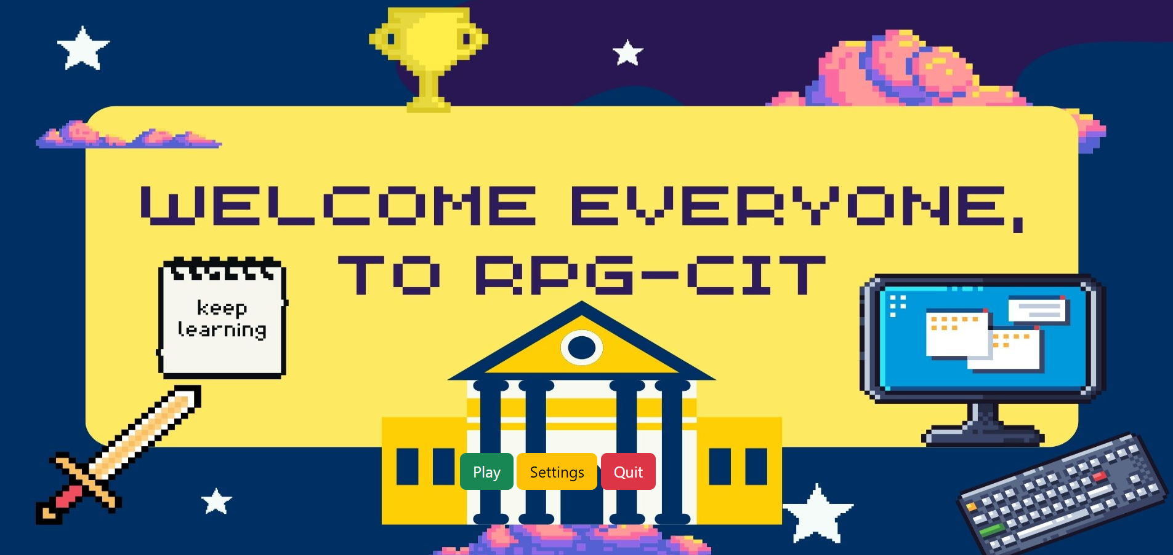

Slide 6
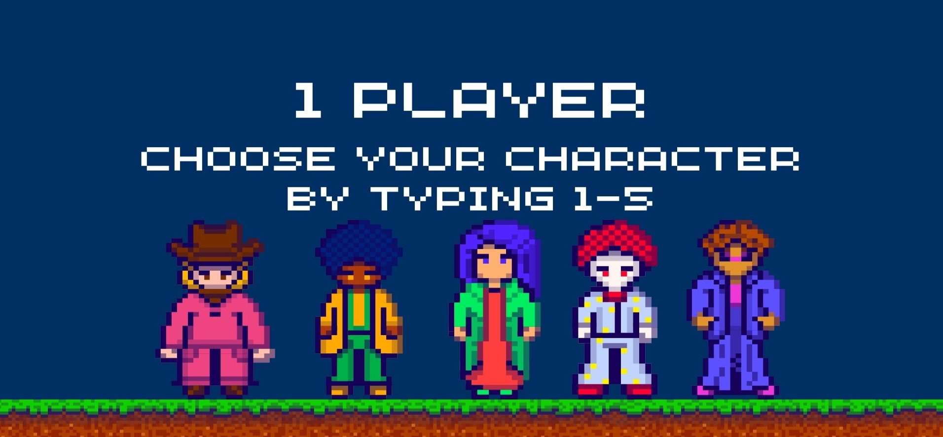

Slide 7
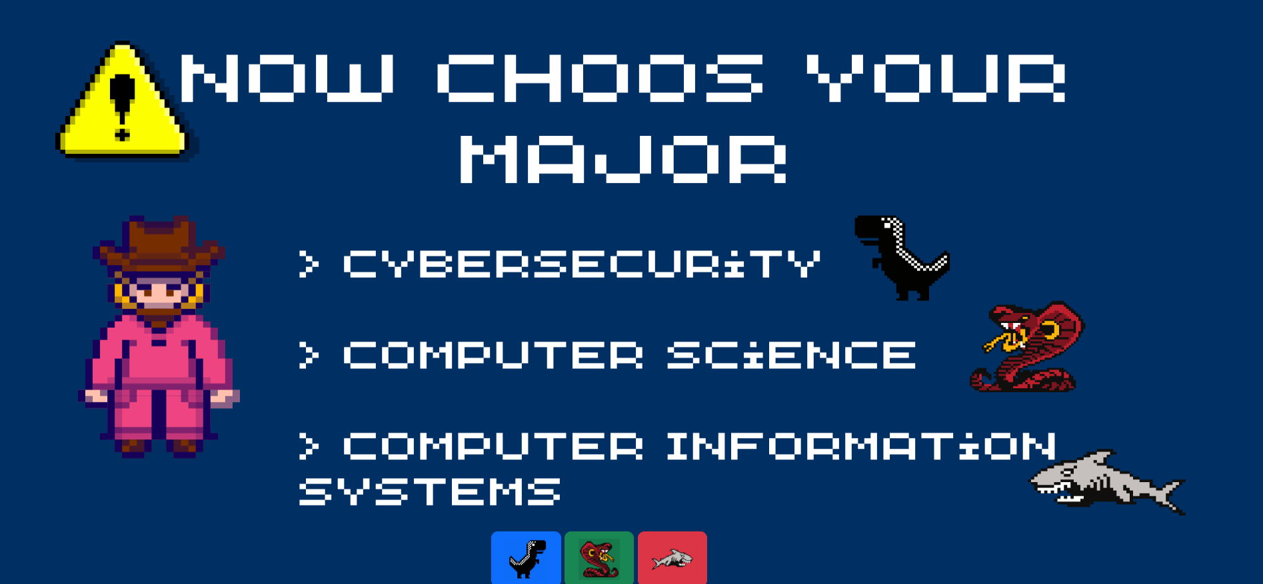

Slide 8
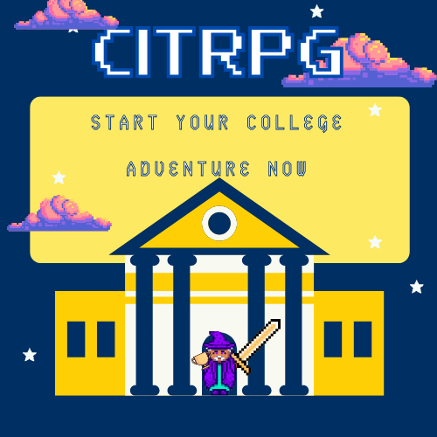
Demo

Slide 9
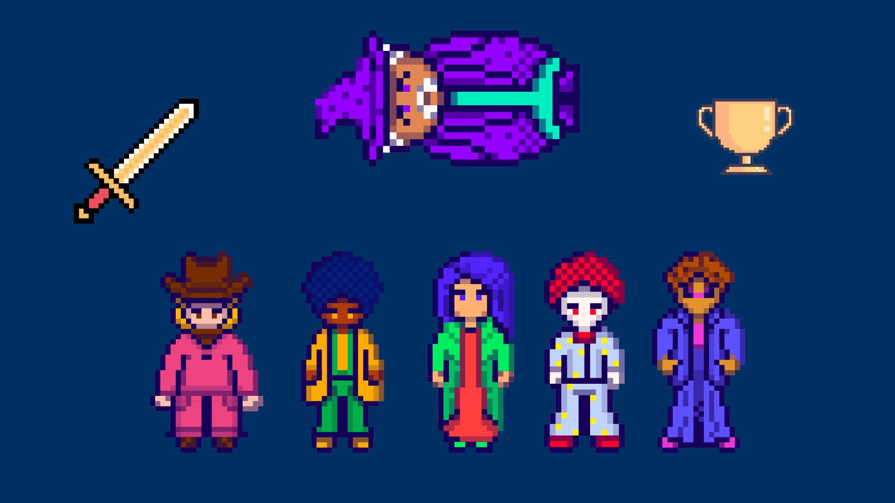
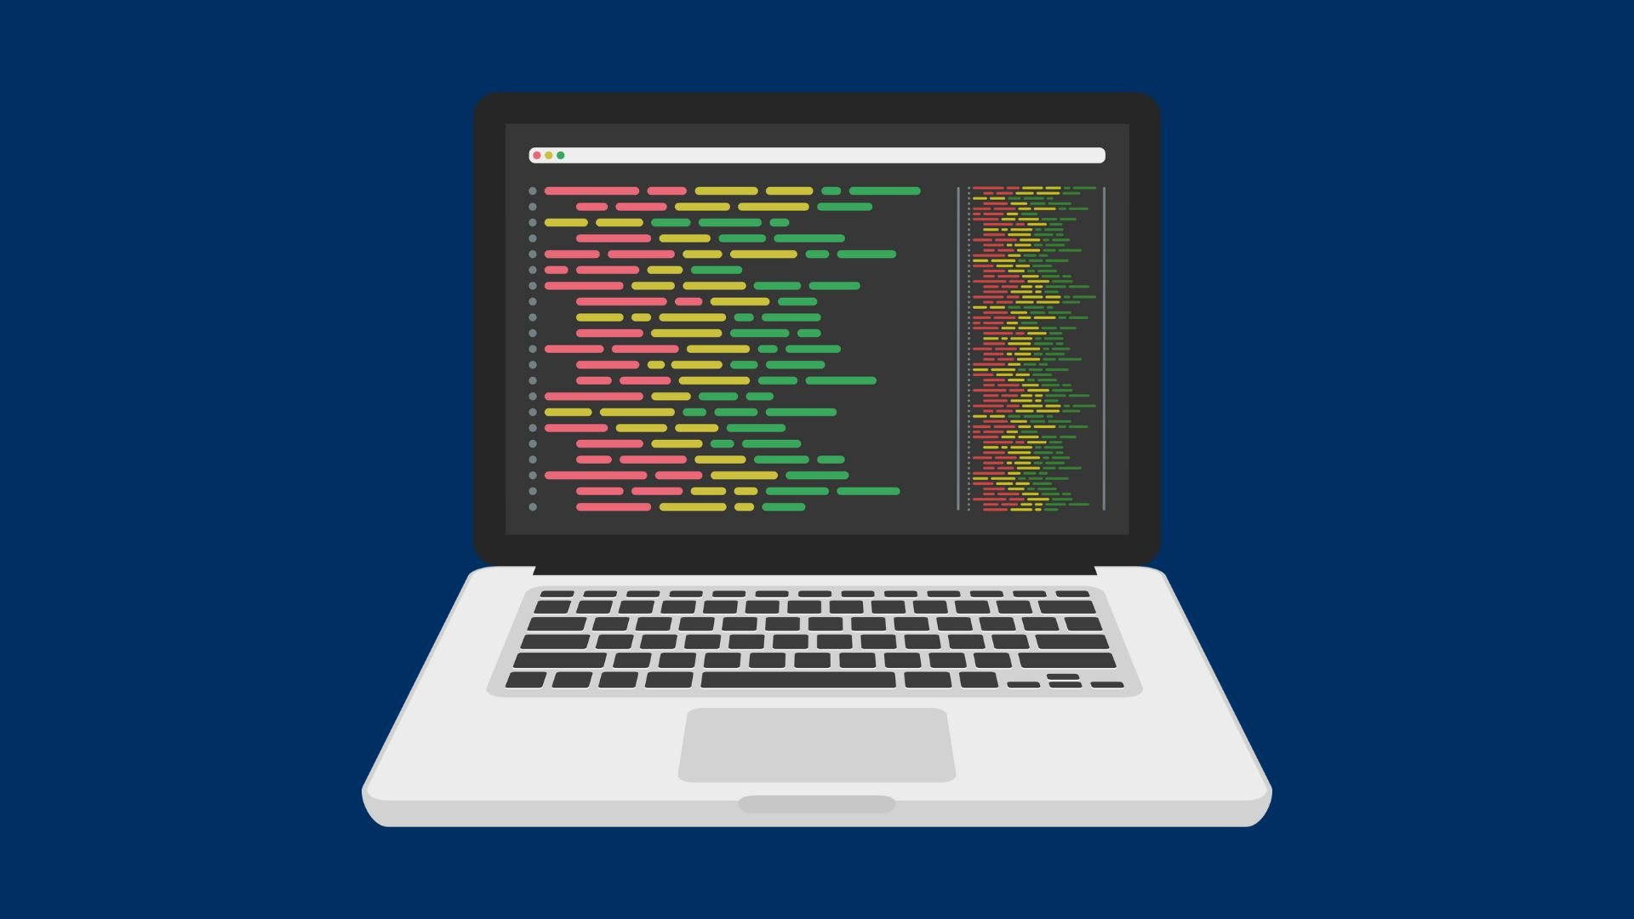
Lessons Learned
Learning to know where certain codes go in place of HTML, CSS, Javascript, and Bootstrap of a document.
Looking through documentation to find resources to help further the development of the game.
Learning to use Canva-created images to further the style process and to help pre plan for the story of the game.
Learning how to lay buttons over images

Slide 10
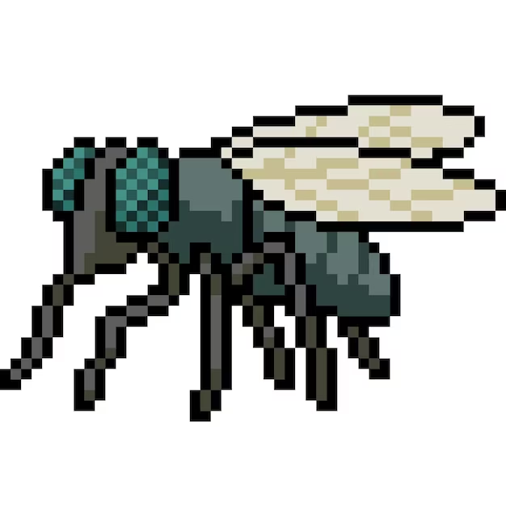

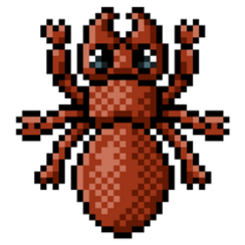


Issues/Bugs Known
CSS styling issues. We had trouble running the document on web browsers and making changes to get it right.
HTML structure errors. Improper nesting of HTML elements, missing or closing tags.
Inputting codes in the wrong areas of the documents.
When picking a character it will only let you choose one character
Once in the game, there is no way to get out or go back unless exiting the entire thing

Slide 11
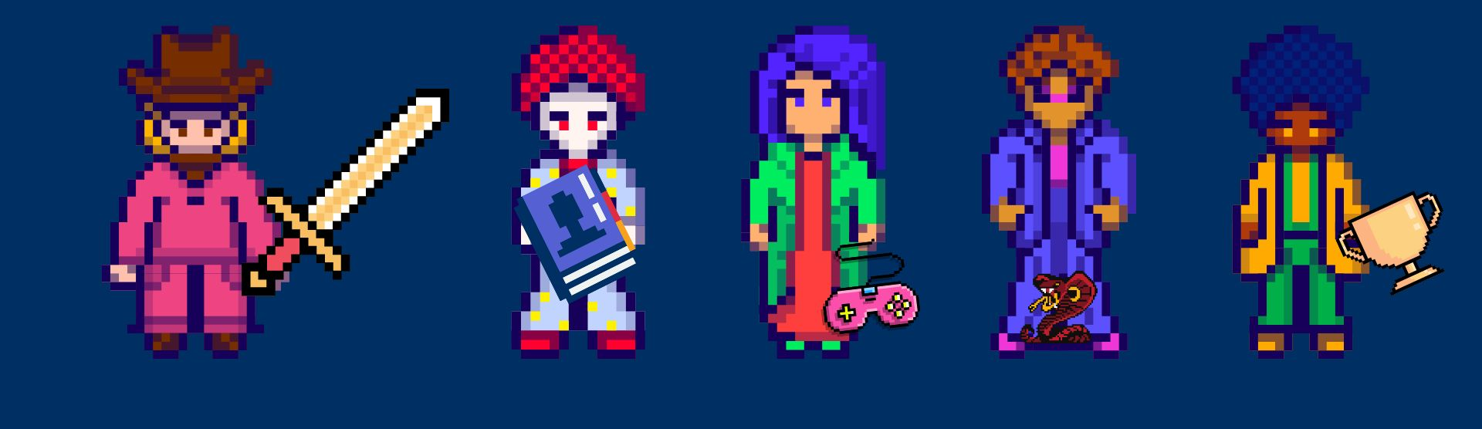
Future Versions
A complete and functional trivia game for everyone to enjoy from selecting characters to levels of difficulty.

Slide 12

Any
Questions?

